Slide 1
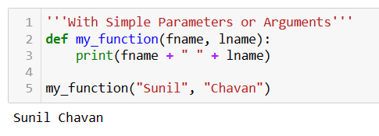
Functions
In Python, a function is a block of reusable code that performs a specific task. Functions also allow programmers to
break down your program into smaller, modular pieces,
making your code more organized,
easier to understand and easier to maintain.
And it starts with def keyword
Python functions may contain attributes or logical structure or both.

Slide 2
Different Type of Functions
Functions
Built-in Functions:
User-defined Functions: (UDF)
Other Function

Slide 3
Build In Functions
print(),
range(),
len(),
input(),
type(),
str(),
int(),
These are in build functions that are always available in Python, no matter which modules are imported.

Slide 4
User-defined Functions:
Simple Function
Lambda Function
def my_function(a): print("Hello from a function")
my_function(a)
double = lambda x: x * 2
User Defined function(UDF)
is a block of code that only runs when it is called. You can pass data, known as parameters, into a function. A function can return data as a result. In Python a function is defined using the def or lambda keyword :

Slide 5
Other Function
Higher-order Functions:
Recursive Functions:
map()
filter()
reduce()
Generator Functions:
Decorator Functions:
Instance Method
Class Method
__init__ Method

Slide 6
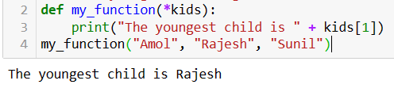
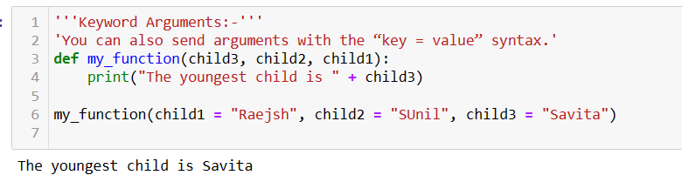
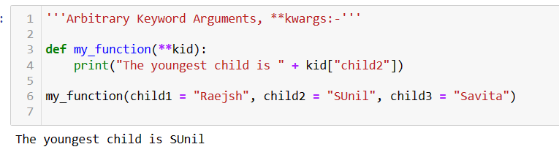
Parameters or Arguments? A parameter or argument is the variable listed inside the parentheses in the function definition. Or it is the value that is sent to the function when it is called.
Arguments
Positional Argument
Arbitrary
Positional Arguments,
*args
Keyword Arguments
Arbitrary
Keyword Arguments,
**kwargs

Slide 7
Lambda Functions:
Syntax of lambda function
lambda arguments : expression
lambda a : a + 10
lambda arguments : true_value if condition else false_value
lambda x,y : x if x>y else y

Slide 8
END OF FUNCTIONS

